Slide 1
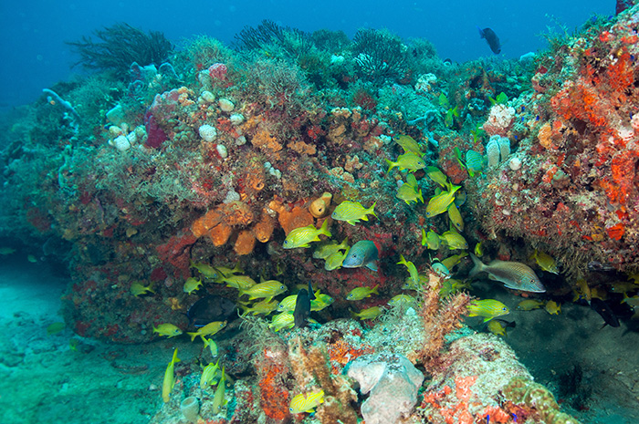
NCRMP, DRM Benthic Data in Miami-Dade County & Biscayne

Slide 2


Important NCRMP data resources
https://github.com/MSE-NCCOS-NOAA/NCRMP_benthics
https://github.com/lexiebsturm/mdcBiscNcrmp
https://ncrmp-visualization-tool-noaa.hub.arcgis.com/

Slide 3
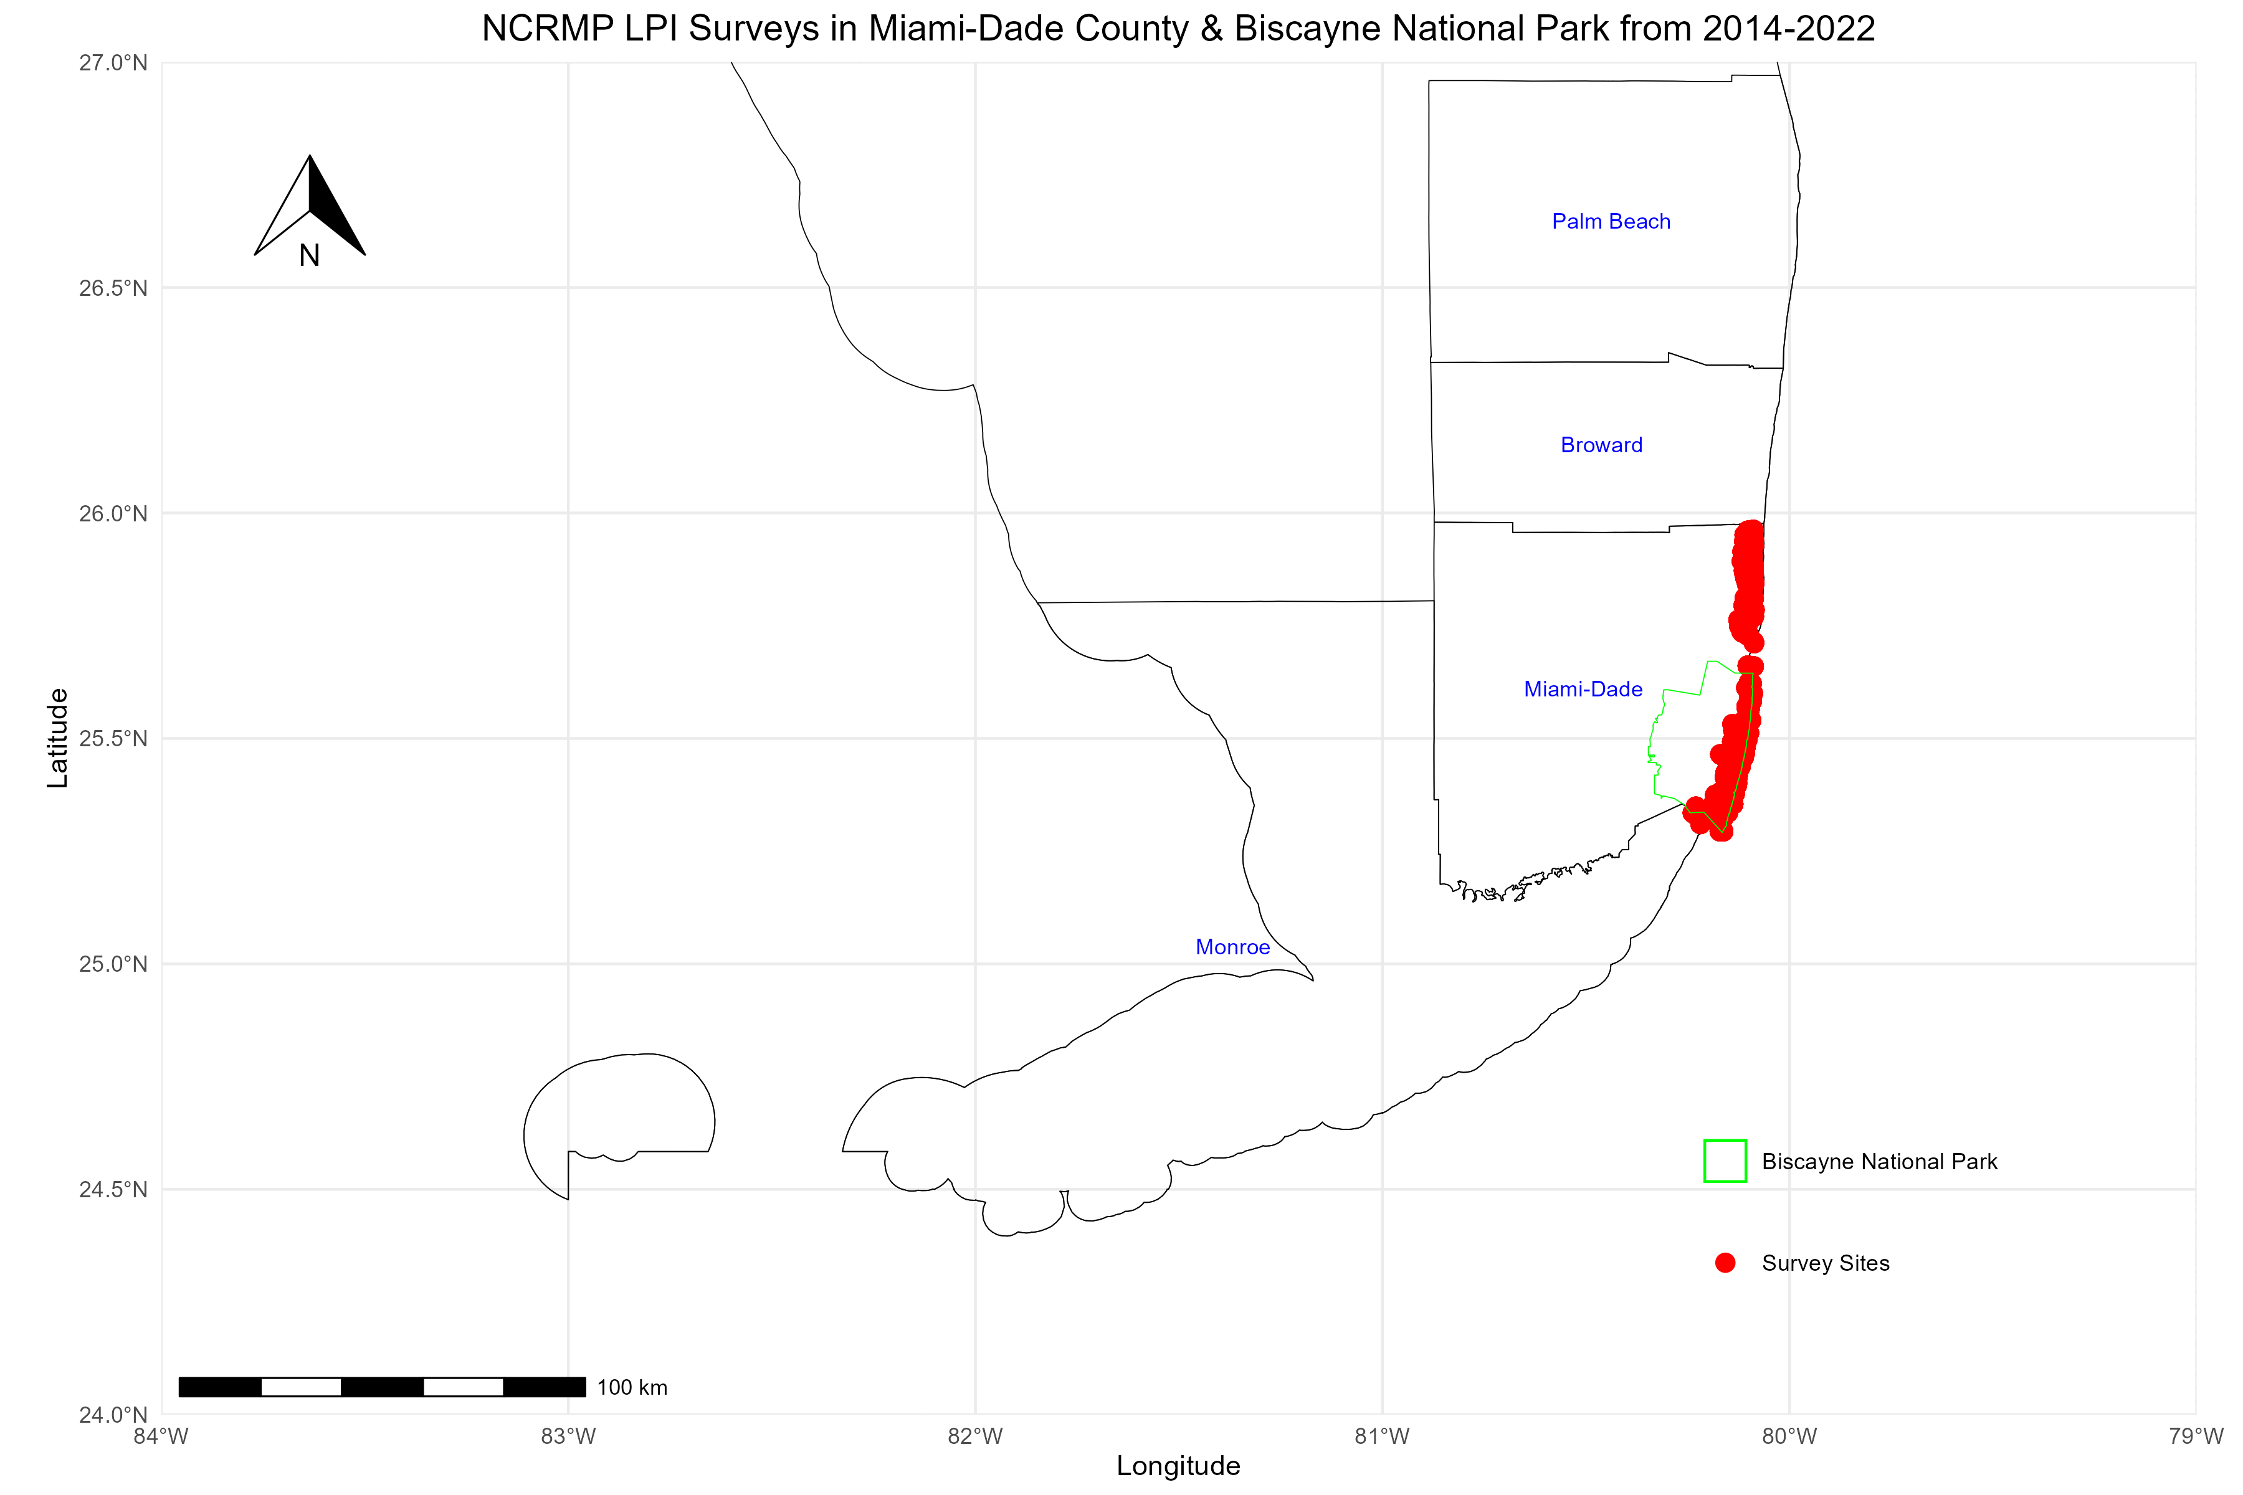
Year | Number of LPI Surveys
2014 | 10
2015 | 43
2016 | 26
2018 | 43
2020 | 17
2021 | 12
2022 | 50
Total pre-2015 | 53
Total post-2015 | 148
Total | 201

Slide 4
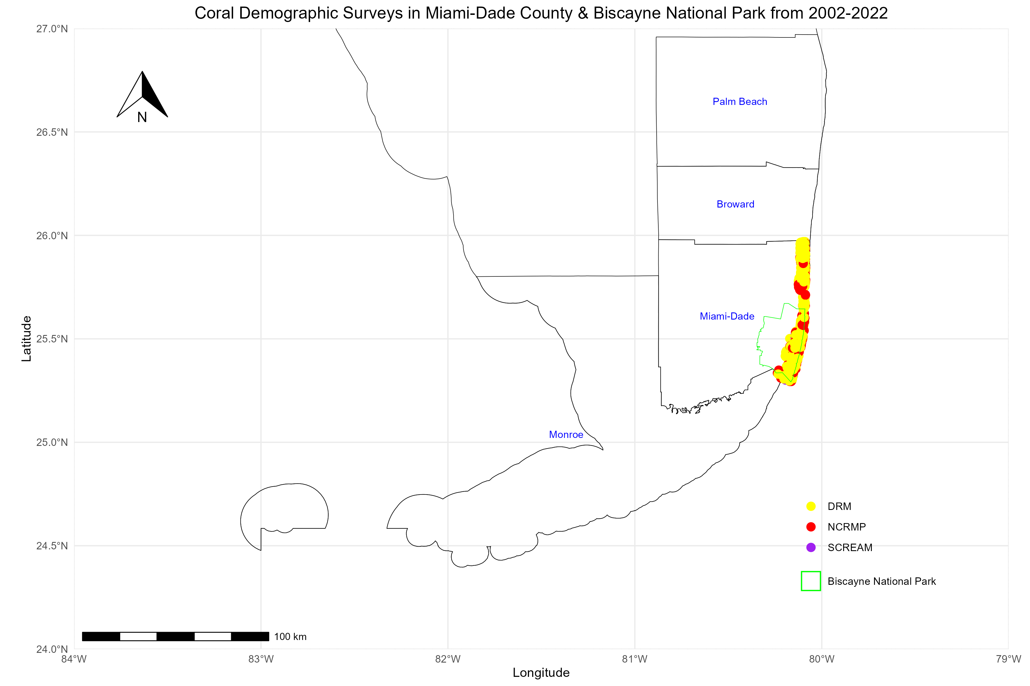

Slide 5
YEAR | SCREAM | DRM | NCRMP | Total Demo Surveys
2002 | 14 | 0 | 0 | 14
2005 | 33 | 27 | 0 | 60
2006 | 0 | 50 | 0 | 50
2007 | 0 | 35 | 0 | 35
2008 | 0 | 31 | 0 | 31
2009 | 0 | 56 | 0 | 56
2010 | 0 | 46 | 0 | 46
2011 | 0 | 58 | 0 | 58
2012 | 17 | 41 | 0 | 58
2013 | 0 | 28 | 0 | 28
2014 | 0 | 29 | 10 | 29
2015 | 0 | 55 | 43 | 55
2016 | 0 | 20 | 25 | 20
2017 | 0 | 20 | 0 | 20
2018 | 0 | 46 | 43 | 46
2019 | 0 | 49 | 0 | 49
2020 | 0 | 59 | 17 | 59
2021 | 0 | 75 | 12 | 75
2022 | 0 | 82 | 50 | 82
Total pre-2015 | 64 | 456 | 53 | 573
Total post-2015 | 0 | 351 | 147 | 498
Total | 64 | 807 | 200 | 1071

Slide 6
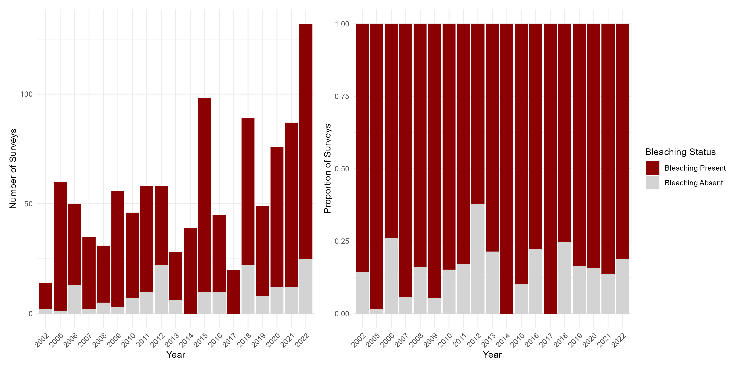
Bleaching Presence/Absence Across Surveys

Slide 7
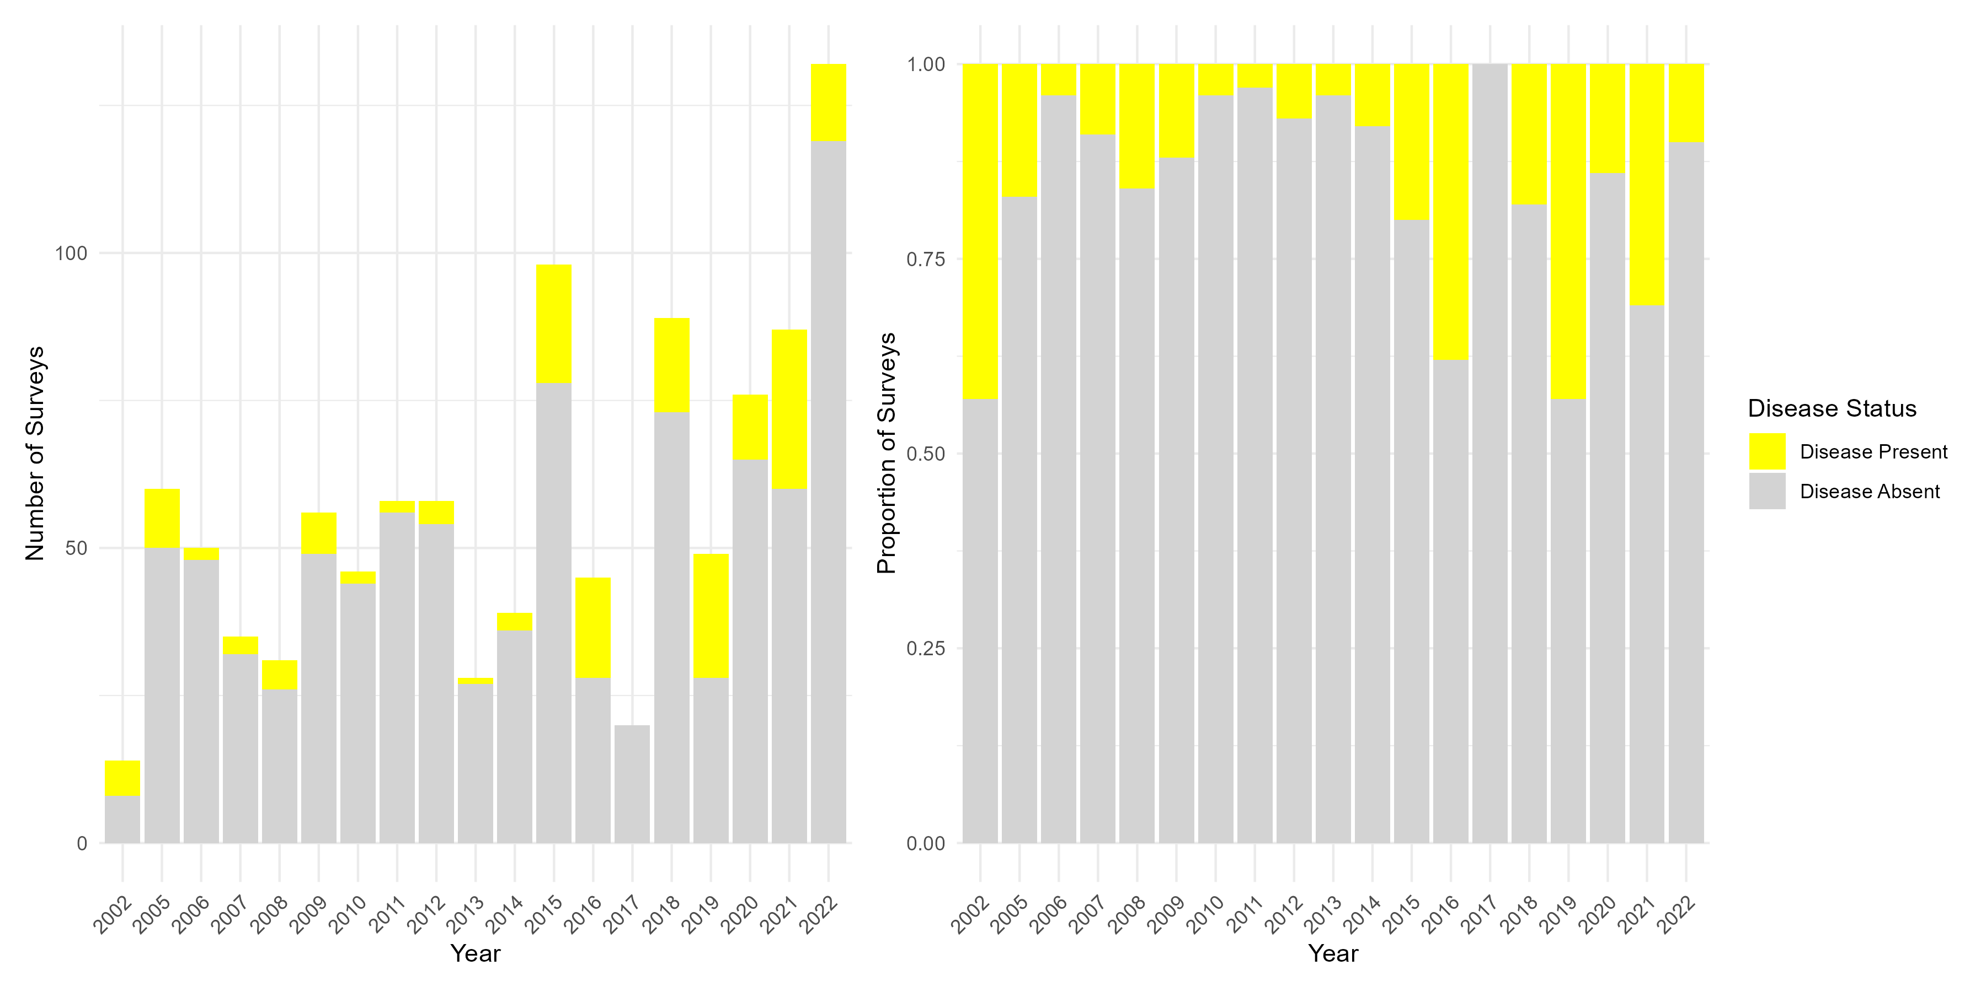
Disease Presence/Absence Across Surveys

Slide 8
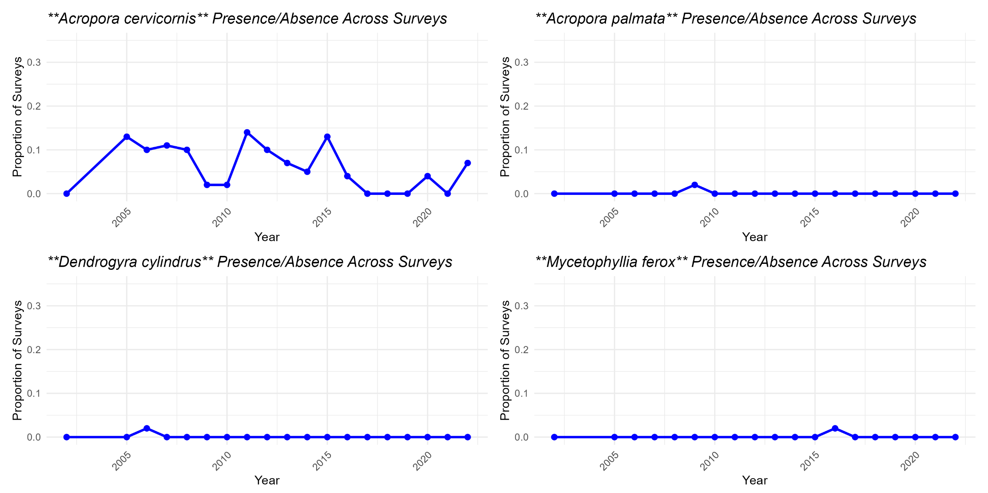
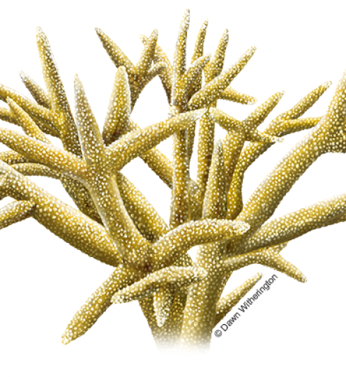
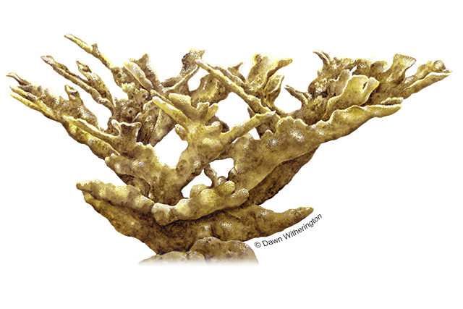
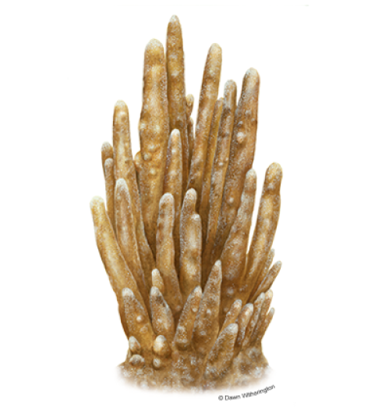
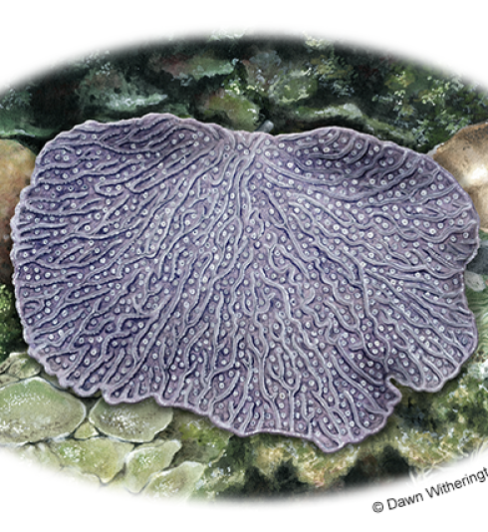
ESA-Listed Spp. Presence/Absence

Slide 9
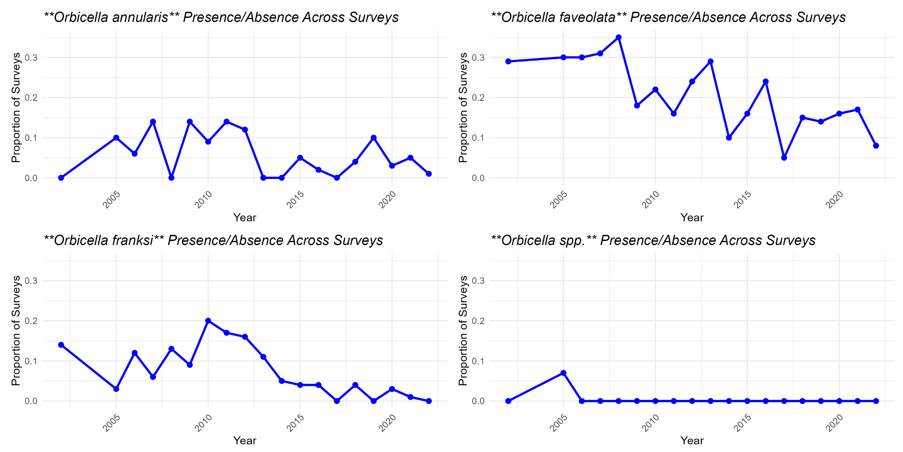
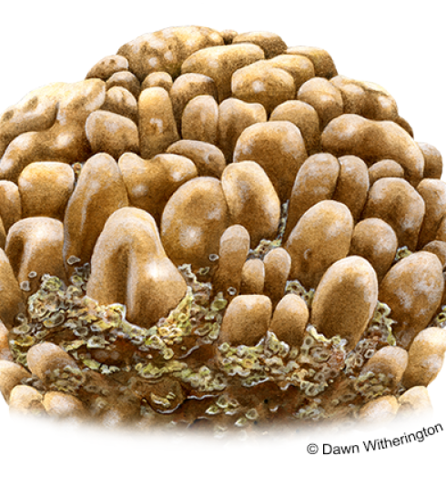
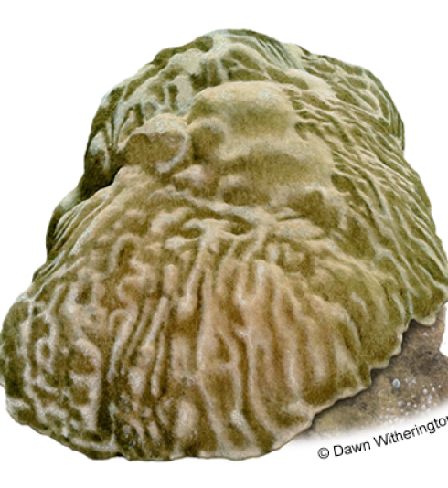
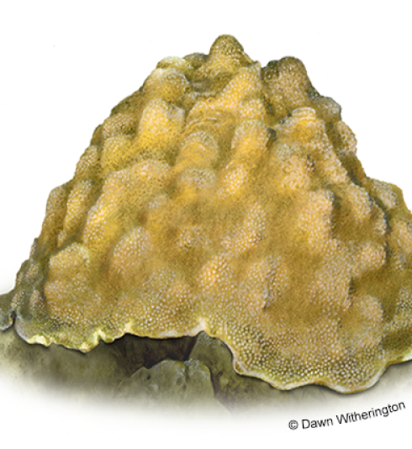
ESA-Listed Spp. Presence/Absence

Slide 10
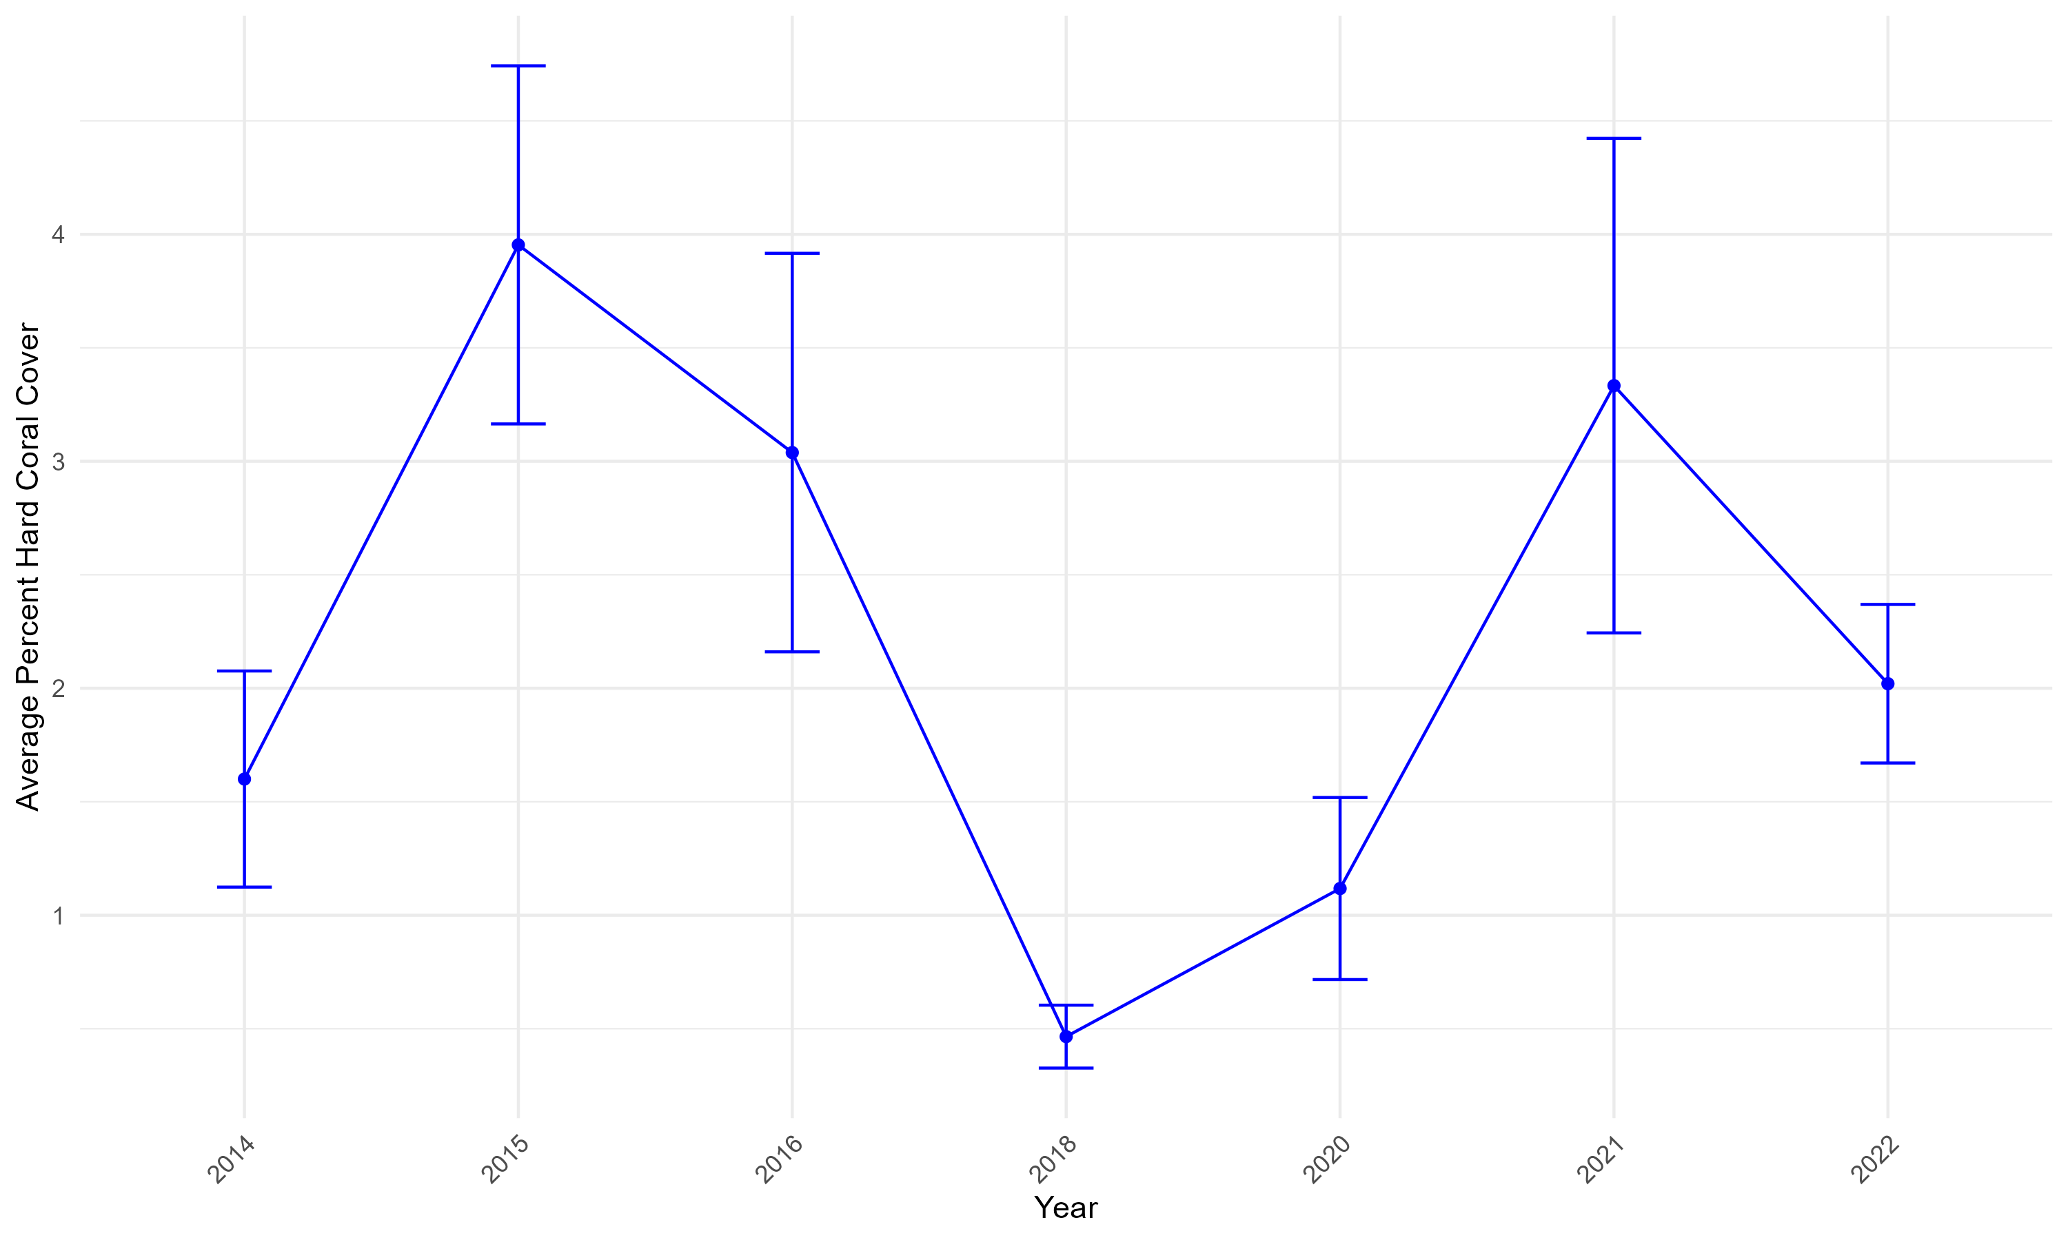
Coral Cover

